Slide 1
Chapter 3
3.3 Motion and Forces
Friction and Air Resistance

Slide 2
Friction
If I push a roll of tape along the counter, it will slow down eventually
Why?
Because the forces are unbalanced
The force that slowed down the tape is called friction

Slide 3
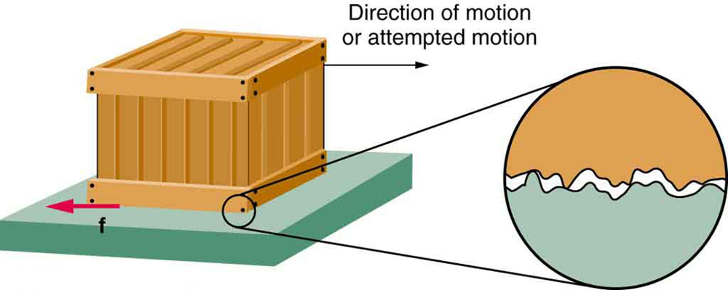
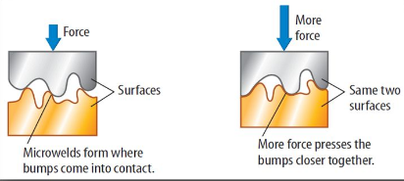
Friction
Friction is the force that opposes the sliding motion of two surfaces that are in contact
What impacts friction?
The size of the frictional force exerted by one surface on another depends on the materials the surfaces are made from and the roughness of the surfaces
Simply put, texture!
Even the most highly polished, shiny and smooth looking metal surfaces have bumps and dips that stick when they are in contact with each other
These bumps and dips form microwelds

Slide 4
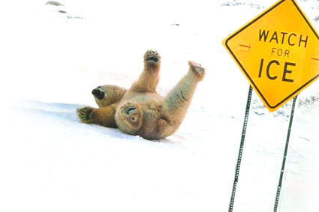
Friction
There are 3 main types of friction
Static
Sliding
Rolling

Slide 5
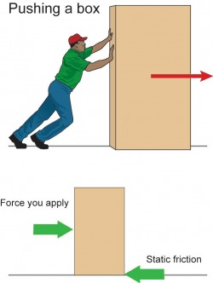
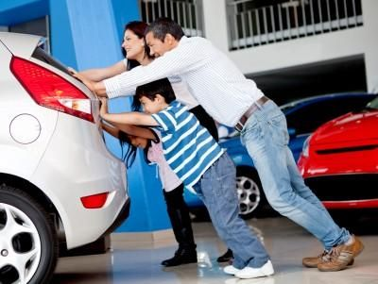
Friction
Static Friction
Frictional Force that prevents two surfaces in contact from sliding past each other
In the example to the right, the static friction balances/is equal to the force the man is applying to the box, so the box does not move
Other examples include pushing a car by yourself…might have a hard time making it budge!
Strongest frictional force

Slide 6
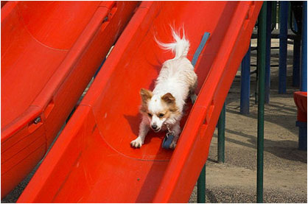
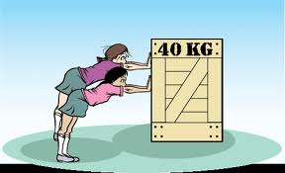
Friction
Sliding Friction
The force that acts in the opposite direction to the motion of a surface sliding on another surface
You need to overcome the static friction for sliding to occur
Sliding friction is ALWAYS opposite the direction of the motion
Intermediate/middle strength frictional force
Smaller than the force due to static friction
Example includes when you slam on the brakes on a car and it slides/skids forward
Applied Force
Sliding Friction

Slide 7
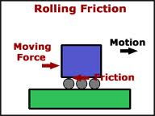
Friction
Rolling Friction
When an object rolls over a surface, a frictional force due to rolling friction slows the object down
Weakest frictional force
Much less than sliding or static friction, which is why it is easier to move a heavy object if it is on wheels

Slide 8
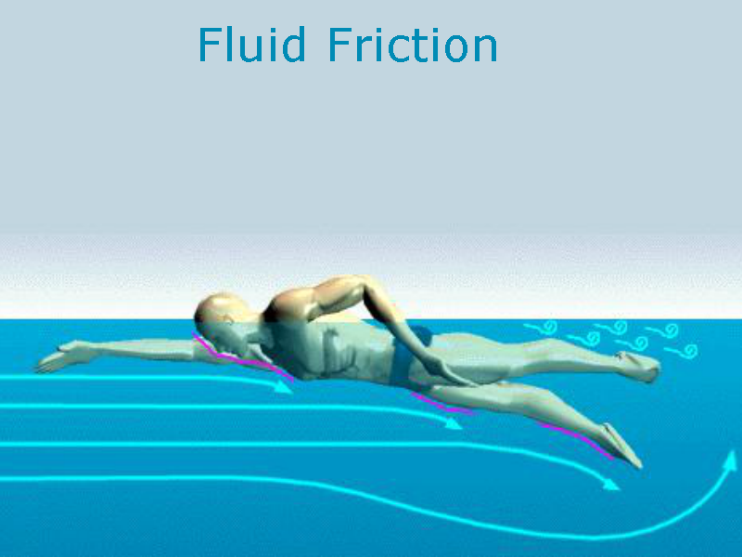
Friction
There’s one additional category of friction that we see
Fluid Friction
The resistance to an object's motion that slows the object down as it moves through a liquid or gas
In a liquid, this is called drag
If this occurs in a gas, it is called air resistance

Slide 9
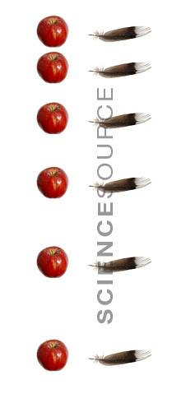
Air Resistance and Terminal Velocity
When a falling object is pulled to earth, its pulled downward by gravity
Air resistance is a frictional force that opposes the motion of objects as they fall through the air
Acts in the opposite direction
If an object is falling downward, air resistance acts upward
If there were no air resistance, all objects would fall at the same speed
The amount of air resistance depends on the speed, size, and shape of the object
When an object is falling, the highest velocity (speed and direction!) the object will reach due to air resistance is called the terminal velocity
In a vacuum, an apple and a feather would fall with the same acceleration because there would be no air resistance.

Slide 10
Let’s Review…
What causes friction?
If I wanted to push a sofa across my living room, how are static friction and sliding friction involved?

